Slide 1



Write Antifragile & Domain-Driven Tests with
QA
Smoke tests Exploratory tests End-to-end tests
Outside-in diamond TDD
contract tests
Integration tests
Acceptance tests
(Coarse-grained “unit” tests)
Thomas PIERRAIN @tpierrain (υѕe caѕe drιven)
unit tests
(Fine-grained)
THOMAS PIERRAIN (@TPIERRAIN)

Slide 2
Write Antifragile & Domain-Driven Tests with
QA
Smoke tests Exploratory tests End-to-end tests
Outside-in diamond TDD
contract tests
Integration tests
Acceptance tests
(Coarse-grained “unit” tests)
Thomas PIERRAIN @tpierrain (υѕe caѕe drιven)
unit tests
(Fine-grained)
THOMAS PIERRAIN (@TPIERRAIN)
Notes:
Bonjour à toutes et à tous. Le TDD a changé la vie du developpeur que je suis.
Ca fait 25 ans que je bosse dans le logiciel, et plus de 16 ans que je fais du TDD.
J’ai du faire à peut près toutes les conneries possibles et imaginables, je vais en présenter quelques unes plus tard, mais suis arrivé, au fil des années de pratiques à être beaucoup plus efficace avec un style un peu particulier. Et c’est de celui-ci dont je voudrai vous parler
Je vous préviens, il y a certaines choses qui risquent de vous troubler, en choquer même certaines ouj certains d’entre vous. C’est ce qui se passe à chaque fois que je présente l’outside-in diamond TDD.
Hello!
(dynamic) Hello everyone! (pause, then slowly) Hello XXXXXX ! Thanks for the invitation.
Tests… (pause) TDD in particular, is one of my fav topic ever. It’s been a while since I started to TDD (more than 15 years now). I’ve made almost every mistake one can imagine with it:
violating encapsulation in order to test private members (don’t do that; -),
implement Fragile tests (because we’ve made tests towards implementation details. Don’t do that ;-),
duplicate production code logic in test (don’t do that),
making less baby steps than one should (don’t do that )
write too much complex tests and setups (don’t do that either), etc.
I’ve talked about TDD in conferences, I live coded publicly many times, I wrote some press articles & blog post about it but I think it’s time for me now, to talk about something that I’ve discovered like 5-4 years ago, and that gave me lots of efficiency and lot of joy at work with the various dev teams I worked with.
Outside-in Diamond is a way of doing TDD (both a workflow, and some important characteristics). We found the name with my associate Bruno Boucard. It allow us to write anti-fragile and Domain-Driven tests.
But before we dive into the topic, let me introduce myself:
My name is Thomas PIERRAIN, I’ve been building software for more than 23 years now. Doing pretty much all the job one can find in IT (and even more): dev, tech-lead, project manager, software architect, enterprise architect, coach, big brother… but I always continued to code aside even when I was involved with C-levels into more organizational topics. Doing some open source for instance. All in .NET, and almost all related to testing: testing fluent assertions with Nfluent, Fuzzers with Diverse, Smoke tests with SmokeMe and some other libraries related to tactical DDD.
I worked in many domains like the gaming industry, finance, health care, music and now in the hospitality industry since almost 2 years.
I split my weeks by managing and coding with an API dev team for an international Hotels group, and do some DDD or architecture consulting and training for other clients the rest of my time.
Last but not least, I’m practicing DDD since more than 10 years and I’m Co-organizer of the DDD meetup in France: DDD FR (you can check the videos of our community on yt, there are some really interesting things)
This evening we will talk about Outside-in TDD, we will show some code, but I finally won’t do some live-code because I did’t manage to have enough time to prepare something interesting for you. I’d rather cancel that part, and I’m truly sorry. But I’d rather do nothing than something crappy . Especially because I’ve lot of things to say before.
Hopefully we will end this session with a Q&A session all together.
Ok? let’s go!

Slide 3
Disclaimers
There is no silver bullet Your testing strategy & techniques must always be chosen accordingly to your context (both human & technical)
As long as you understand your trade-offs there is no reason not to explore new paths…
Thanks to Kent Beck, Martin Fowler, Michael Feathers, Nat Pryce & Steve Freeman for their great source of inspiration over the years #shouldersOfGiants
Notes:
I want to make a few disclaimers here. Because it’s important:

Slide 4
Preamble

Slide 5

I ❤ DDD hence I ❤ …
(Contextualized)
Services
THOMAS PIERRAIN (@TPIERRAIN)
Notes:
Petit disclaimer :
Je vous l’ai dit, je fais du DDD depuis longtemps et quand on fait du DDD on aime bien aligner son code et ses architectures sur des considerations métiers.
Dans les faits, des architectures orientées services / orientées API permettent de bien scaler tout en restant consistant par rapport à des contexts métiers.
Des contexts en DDD, on les représente sous forme de patates ,comme ici
(click, click, clik)
Tout ça pour vous dire, qu’une grosse partie de mon job c’est de faire émerger des APIs et de les faire communiquer les unes avec les autres.
Je ne parle pas de micro-service (qui est une mode), je parle de services ou d’API alignées par rapport au métier et qui sont conscients du context -et donc des modèles- dans lequels ils gravitent. C’est ça qui permet un bon time to market, une autonomie des équipes et des systems.
(next)
Image : https://insights-images.thoughtworks.com/pairprogramming_f0d3ae7ef121e981e150bfcae4ecb995.jpg

Slide 6

I ❤ DDD hence I ❤ …
E-commerce
BFF API
d
d
Booking API
CMS API
d
U
d
U
Payment
Marketing
U
Accounts API
PSP API
Central Reservation
Loyalty API
U
CRS API
(Contextualized)
Services
U
Stay
d
d
Revenue Mgmt
d
U
Property Management System (PMS)
U
Rates & Cancellation rules API
Distribution
THOMAS PIERRAIN (@TPIERRAIN)
Resorts
Referential
Metasearch API
d
U
Hospitality
Notes:
Petit disclaimer :
Je vous l’ai dit, je fais du DDD depuis longtemps et quand on fait du DDD on aime bien aligner son code et ses architectures sur des considerations métiers.
Dans les faits, des architectures orientées services / orientées API permettent de bien scaler tout en restant consistant par rapport à des contexts métiers.
Des contexts en DDD, on les représente sous forme de patates ,comme ici
(click, click, clik)
Tout ça pour vous dire, qu’une grosse partie de mon job c’est de faire émerger des APIs et de les faire communiquer les unes avec les autres.
Je ne parle pas de micro-service (qui est une mode), je parle de services ou d’API alignées par rapport au métier et qui sont conscients du context -et donc des modèles- dans lequels ils gravitent. C’est ça qui permet un bon time to market, une autonomie des équipes et des systems.
(next)
Image : https://insights-images.thoughtworks.com/pairprogramming_f0d3ae7ef121e981e150bfcae4ecb995.jpg

Slide 7
I ❤ DDD hence I ❤ …
E-commerce
BFF API
d
d
Booking API
CMS API
d
U
d
U
Payment
Marketing
U
Accounts API
PSP API
Central Reservation
Loyalty API
U
CRS API
(Contextualized)
Services
U
Stay
d
d
Revenue Mgmt
d
U
Property Management System (PMS)
U
Rates & Cancellation rules API
Distribution
THOMAS PIERRAIN (@TPIERRAIN)
Resorts
Referential
Metasearch API
d
U
Hospitality
Notes:
Et c’est pour ça que je ne vais pas parler de tests front dans mes exemples, mais ça ne signifie pas que ce que je vais vous dire n’est pas applicable pour tout type de tests, au contraire.
Mais il y aura des spécificités de temps en temps, comme un peu d’architecture hexagonale par ex (plutôt approprié pour du back).
Image : https://insights-images.thoughtworks.com/pairprogramming_f0d3ae7ef121e981e150bfcae4ecb995.jpg

Slide 8
DDD & TDD also love…
Our WeB API
HTTP
Infrastructure
Adapter
Domain
Ports & Adapters
Adapter
THOMAS PIERRAIN (@TPIERRAIN)
HTTP
API
Notes:
L’archi hexagonale ça ressemble à ça vu d’avion
Image : https://insights-images.thoughtworks.com/pairprogramming_f0d3ae7ef121e981e150bfcae4ecb995.jpg

Slide 9
DDD & TDD also love…
Our WeB API
HTTP
Infrastructure
Easy to test
Protect Domain code from Infra fads
Quick feedback (carpaccio-style slicing)
Allow late
architectural decisions
Composable: modular-monolith ready
Adapter
Domain
Ports & Adapters
Adapter
THOMAS PIERRAIN (@TPIERRAIN)
HTTP
API
Notes:
Image : https://insights-images.thoughtworks.com/pairprogramming_f0d3ae7ef121e981e150bfcae4ecb995.jpg

Slide 10
DDD & TDD also love…
Domain First
Infrastructure
Adapter
Adapter
Domain
Ports & Adapters
Adapter
Adapter
THOMAS PIERRAIN (@TPIERRAIN)
Notes:
Image : https://insights-images.thoughtworks.com/pairprogramming_f0d3ae7ef121e981e150bfcae4ecb995.jpg

Slide 11
DDD & TDD also love…
Deploy as you wish
Our WeB API
HTTP
Infrastructure
Adapter
Domain
Ports & Adapters
Adapter
THOMAS PIERRAIN (@TPIERRAIN)
HTTP
API
Notes:
Image : https://insights-images.thoughtworks.com/pairprogramming_f0d3ae7ef121e981e150bfcae4ecb995.jpg

Slide 12
Let’s talk about tests!

Slide 13


A world of Tests
ET
Exploratory Tests (E2E)
IT
Integration Tests (Contract)
Different Types
AT
(coarse-grained unit) Acceptance Tests
THOMAS PIERRAIN (@TPIERRAIN)
UT
(fine-grained) Unit Tests

Slide 14
Why do I do TDD?

Slide 15
Made me…
Test Driven
development
Baby steps eradicate Procrastination and premature optimizations
Less debugging with Live testing tools
No regression
More relaxed
More efficient
More relevant
THOMAS PIERRAIN (@TPIERRAIN)
YAGNI ( Outside-in form )
Shared and clarified mental models
Notes:
Premature optimization: Split the make it work and the make it better
YAGNI: focus only on what really matter.
More relaxed (détendu) – Against Procrastination and premature optimizations
More efficient (efficace) – Progressive consolidation with baby steps
More relevant (pertinent) – Outside-in embraces YAGNI
Image: https://miro.medium.com/max/13440/1*o7WmwGkLVR0dVQUYqfSBeg.jpeg

Slide 16
TDD Workflows

Slide 17
Outside-in
Test Driven
development
THOMAS PIERRAIN (@TPIERRAIN)
Notes:
Image: https://miro.medium.com/max/13440/1*o7WmwGkLVR0dVQUYqfSBeg.jpeg

Slide 18
Outside-in
Test Driven
development
AT
THOMAS PIERRAIN (@TPIERRAIN)
Notes:
Image: https://miro.medium.com/max/13440/1*o7WmwGkLVR0dVQUYqfSBeg.jpeg

Slide 19
Outside-in
Test Driven
development
AT
THOMAS PIERRAIN (@TPIERRAIN)
Notes:
Image: https://miro.medium.com/max/13440/1*o7WmwGkLVR0dVQUYqfSBeg.jpeg

Slide 20
Outside-in
Test Driven
development
AT
AT
THOMAS PIERRAIN (@TPIERRAIN)
Notes:
Image: https://miro.medium.com/max/13440/1*o7WmwGkLVR0dVQUYqfSBeg.jpeg

Slide 21
Outside-in
Test Driven
development
AT
AT
AT
THOMAS PIERRAIN (@TPIERRAIN)
Notes:
Image: https://miro.medium.com/max/13440/1*o7WmwGkLVR0dVQUYqfSBeg.jpeg

Slide 22
Outside-in
Test Driven
development
AT
AT
AT
AT
THOMAS PIERRAIN (@TPIERRAIN)
Notes:
Image: https://miro.medium.com/max/13440/1*o7WmwGkLVR0dVQUYqfSBeg.jpeg

Slide 23
Outside-in
Test Driven
development
AT
AT
AT
AT
AT
THOMAS PIERRAIN (@TPIERRAIN)
Notes:
Image: https://miro.medium.com/max/13440/1*o7WmwGkLVR0dVQUYqfSBeg.jpeg

Slide 24
Outside-in
Test Driven
development
AT
AT
AT
AT
AT
AT
THOMAS PIERRAIN (@TPIERRAIN)
Notes:
Image: https://miro.medium.com/max/13440/1*o7WmwGkLVR0dVQUYqfSBeg.jpeg

Slide 25
Outside-in
Test Driven
development
AT
AT
AT
AT
AT
AT
AT
THOMAS PIERRAIN (@TPIERRAIN)
Notes:
Image: https://miro.medium.com/max/13440/1*o7WmwGkLVR0dVQUYqfSBeg.jpeg

Slide 26
Inside-out
Test Driven
development
THOMAS PIERRAIN (@TPIERRAIN)
Notes:
Image: https://miro.medium.com/max/13440/1*o7WmwGkLVR0dVQUYqfSBeg.jpeg

Slide 27
Inside-out
Test Driven
development
UT
THOMAS PIERRAIN (@TPIERRAIN)
Notes:
Image: https://miro.medium.com/max/13440/1*o7WmwGkLVR0dVQUYqfSBeg.jpeg

Slide 28
Inside-out
Test Driven
development
UT
UT
API
THOMAS PIERRAIN (@TPIERRAIN)
Notes:
Image: https://miro.medium.com/max/13440/1*o7WmwGkLVR0dVQUYqfSBeg.jpeg

Slide 29
Inside-out
Test Driven
development
UT
UT
API
UT
THOMAS PIERRAIN (@TPIERRAIN)
Notes:
Image: https://miro.medium.com/max/13440/1*o7WmwGkLVR0dVQUYqfSBeg.jpeg

Slide 30
Inside-out
Test Driven
development
UT
UT
API
UT
THOMAS PIERRAIN (@TPIERRAIN)
UT
Notes:
Image: https://miro.medium.com/max/13440/1*o7WmwGkLVR0dVQUYqfSBeg.jpeg

Slide 31
Inside-out
Test Driven
development
UT
UT
API
UT
UT
THOMAS PIERRAIN (@TPIERRAIN)
UT
Notes:
Image: https://miro.medium.com/max/13440/1*o7WmwGkLVR0dVQUYqfSBeg.jpeg

Slide 32
Inside-out
Test Driven
development
UT
UT
API
UT
UT
THOMAS PIERRAIN (@TPIERRAIN)
UT
UT
Notes:
Image: https://miro.medium.com/max/13440/1*o7WmwGkLVR0dVQUYqfSBeg.jpeg

Slide 33
Inside-out
Test Driven
development
UT
UT
API
UT
UT
THOMAS PIERRAIN (@TPIERRAIN)
UT
UT
UT
Notes:
Image: https://miro.medium.com/max/13440/1*o7WmwGkLVR0dVQUYqfSBeg.jpeg

Slide 34
Inside-out
Test Driven
development
UT
UT
AT
API
UT
UT
THOMAS PIERRAIN (@TPIERRAIN)
UT
UT
UT
Notes:
Image: https://miro.medium.com/max/13440/1*o7WmwGkLVR0dVQUYqfSBeg.jpeg

Slide 35
Inside-out
Test Driven
development
AT
UT
UT
AT
API
UT
UT
THOMAS PIERRAIN (@TPIERRAIN)
UT
UT
UT
Notes:
Image: https://miro.medium.com/max/13440/1*o7WmwGkLVR0dVQUYqfSBeg.jpeg

Slide 36
Workflows
Test Driven
development
API
…
API
…
Outside-in
Inside-out
THOMAS PIERRAIN (@TPIERRAIN)
Notes:
Image: https://miro.medium.com/max/13440/1*o7WmwGkLVR0dVQUYqfSBeg.jpeg

Slide 37
Common pitfalls & mitigations
Notes:
Je vous ai dit tout à l’heure que j’avais rate à peu près tout ce qui était possible de rater en faisant du TDD tout au long de mes premières années de pratique.
Voyons maintenant ensemble quelques un des pièges ou difficulties dans lesquelles on peut tomber quand on fait du TDD.

Slide 38

Test Driven
development
When we test Implementations instead of behaviours ; - (
Because We tend to overlook some boring but crucial areas ( like adapters code )
1. Fragile tests
2. Blind spots
3. Complex setups
When ( Unit x Integration )
Test coverage is not enough
Beware of…
THOMAS PIERRAIN (@TPIERRAIN)
cognitive overload reduces stamina
and engagement
Notes:
Alors…. Déjà…
1. attention au tests fragiles.
- C’est quoi un test fragile ? C’est un test qui casse un peu trop souvent quand on veut changer notre code (on va le voir après avec une petite animation)
2. Attention aux angles morts, ca.d à tout ces petits endroits ou les bacteries attaquent.. Ou les bugs apparaissent.
3. Attention aux tests trop compliqués. Ca fatigue tout le monde de lire du code procedural pissé à la ligne.
Si vous ne faites pas attention à la qualité et à la lisibilité de votre code de tests => tout va se dégrader.
Bon. On va zoomer un peu sur ces 3 types de difficultés avec quelques animations pour render ça plus lisible. Ok ?
------------------------------------
Cognitive overload reduce stamina ➔ Pit of failure. Like a broken window syndrome.
https://www.welcometothejungle.com/en/articles/cognitive-overload-at-work
Image : https://encrypted-tbn0.gstatic.com/images?q=tbn:ANd9GcRUkEI7a62LZWV7URYcN5jClByl0GkP6ReZvA&usqp=CAU
I could have added
Non deterministic
The team must be confident in their tests
Fragile tests / Painful Refactoring
Messy test code
Slowness
Non deterministic

Slide 39
Test Driven
development
API
uses
uses
1.
Beware of… Fragile tests
Notes:
When we have situations like this

Slide 40
Test Driven
development
AT1
AT2
UT6
API
UT1
uses
UT5
1.
Beware of… Fragile tests
UT2
THOMAS PIERRAIN (@TPIERRAIN)
UT3
UT4
Notes:
When we have situations like this

Slide 41
Test Driven
development
AT1
AT2
UT6
API
UT1
uses
UT5
1.
Beware of… Fragile tests
Now we want to change our implementation here
UT2
THOMAS PIERRAIN (@TPIERRAIN)
UT3
UT4
Notes:
When we have situations like this

Slide 42
Test Driven
development
AT1
AT2
UT6
API
UT1
uses
UT5
1.
Beware of… Fragile tests
UT2
THOMAS PIERRAIN (@TPIERRAIN)
UT3
UT4

Slide 43
Test Driven
development
AT1
AT2
UT6
😕
😕
API
UT1
😕
uses
UT5
1.
Beware of… Fragile tests
😕
UT2
😕
😕
😕
THOMAS PIERRAIN (@TPIERRAIN)
UT3
UT4

Slide 44
Test Driven
development
AT1
AT2
UT6
😕
😕
API
UT1
😕
uses
UT5
Fragile tests
➔ Less refactoring
UT2
😕
😕
😕
😕
THOMAS PIERRAIN (@TPIERRAIN)
UT3
UT4

Slide 45
Test Driven
development
AT
AT
UT
😕
Mitigations
Do not test “implementations”
Focus on external behaviours instead (with Outside-in TDD)
Favor (coarse-grained unit) Acceptance tests over fine-grained unit tests
API
UT
😕
uses
UT
Fragile tests
AP
…
…
UT
😕
😕
😕
THOMAS PIERRAIN (@TPIERRAIN)
UT
UT
AT
Notes:
Do not test “implementations” . Nat Pryce and Steve Freeman wrote in their tremendous GOOS book: “Unit-test Behavior, not methods”.
This has also been repeatedly said by Ian Cooper again and again (with his great talk about it named: “TDD, where did it all go wrong”)
So yes. Nothing new here. But I had to repeat it again and again myself too.
Du coup ma traduciton à moi : écrivez des tests d’acceptation gros grains, c’est à dire des tests qui s’appliquent sur des gros trucs: dont le sujet à l’étude est une API par exemple . Vous allez testez des petites choses, mais à chaque fois sur un ensemble consequent.
N’écrivez pas forcément de tests sur des petites choses, comme des classes, des types, et encore moins des méthodes. Et quand vous le ferez, dans la plupart des cas (pour advancer sur le design ou des parties compliquées), n’hésitez pas à les supprimer ensuite (un peu comme l’analogie qu’aime bien mon pote et associé Bruno : des petits tasseaux de bois qui nous aident à monter un mur en brique.
Bon, j’imagine que j’aurai pleins de questions ou d’objections là-dessus.

Slide 46
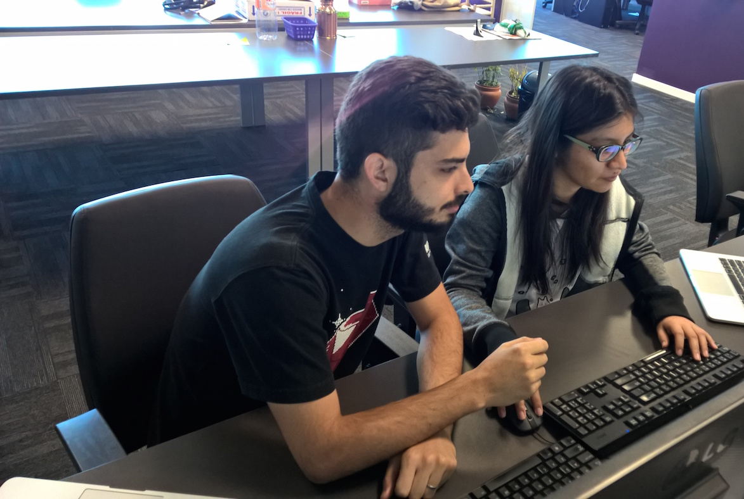
Test Driven
development
⚠ Disclaimer
Test Coverage will be a visual help to identify blind spots in our code here
It doesn’t mean that test coverage is a must
2.
Beware of… Blind Spots
THOMAS PIERRAIN (@TPIERRAIN)
Notes:
Image : https://insights-images.thoughtworks.com/pairprogramming_f0d3ae7ef121e981e150bfcae4ecb995.jpg

Slide 47
Test Driven
development
Our WeB API
HTTP
Infrastructure
Adapter
Domain
2.
Beware of… Blind Spots
Adapter
HTTP
API
THOMAS PIERRAIN (@TPIERRAIN)
Notes:
Image : https://insights-images.thoughtworks.com/pairprogramming_f0d3ae7ef121e981e150bfcae4ecb995.jpg

Slide 48
Test Driven
development
Test the domain code with { acceptance | unit tests }
Domain
2.
Beware of… Blind Spots
THOMAS PIERRAIN (@TPIERRAIN)
Notes:
Image : https://insights-images.thoughtworks.com/pairprogramming_f0d3ae7ef121e981e150bfcae4ecb995.jpg

Slide 49
Test Driven
development
Test the domain code with { acceptance | unit tests }
Adapter
Domain
2.
Beware of… Blind Spots
Adapter
HTTP
Test the infra code (i.e. Adapters) with contract (integration) tests
API
THOMAS PIERRAIN (@TPIERRAIN)
Notes:
Image : https://insights-images.thoughtworks.com/pairprogramming_f0d3ae7ef121e981e150bfcae4ecb995.jpg

Slide 50
Test Driven
development
AT
AT
AT
AT
AT
AT
AT
AT
AT
AT
AT
AT
Domain
AT
AT
AT
100% covered
by Acceptance Tests
Stub
HTTP
2.
Beware of… Blind Spots
API
Right Adapter
80%
IT
IT
IT
⬄
IT
THOMAS PIERRAIN (@TPIERRAIN)
Contract tests
Stub
Notes:
Image : https://insights-images.thoughtworks.com/pairprogramming_f0d3ae7ef121e981e150bfcae4ecb995.jpg

Slide 51

Test Driven
development
As DEV we
to write Domain-Driven tests
AT
AT
AT
AT
AT
AT
AT
AT
AT
AT
AT
AT
Domain
AT
AT
AT
100% covered
by Acceptance Tests
Stub
HTTP
2.
Beware of… Blind Spots
API
Right Adapter
80%
IT
IT
IT
⬄
IT
THOMAS PIERRAIN (@TPIERRAIN)
Contract tests
Stub
Notes:
Image : https://insights-images.thoughtworks.com/pairprogramming_f0d3ae7ef121e981e150bfcae4ecb995.jpg

Slide 52

Test Driven
development
As DEV we
to write Domain-Driven tests
AT
AT
AT
AT
AT
AT
AT
AT
AT
AT
AT
AT
Domain
AT
AT
AT
100% covered
by Acceptance Tests
Stub
HTTP
2.
Beware of… Blind Spots
API
Right Adapter
80%
BUG
BUG
IT
IT
IT
⬄
IT
THOMAS PIERRAIN (@TPIERRAIN)
Contract tests
Stub
Notes:
Image : https://insights-images.thoughtworks.com/pairprogramming_f0d3ae7ef121e981e150bfcae4ecb995.jpg

Slide 53
Test Driven
development
As DEV we
to write Domain-Driven tests
AT
AT
AT
AT
AT
AT
AT
AT
AT
AT
AT
AT
Domain
AT
AT
AT
100% covered
by Acceptance Tests
Stub
HTTP
2.
Beware of… Blind Spots
API
As DEV we don’t write enough integration tests
Because they are slow to run & boring
➔
Right Adapter
80%
BUG
BUG
IT
IT
IT
⬄
IT
THOMAS PIERRAIN (@TPIERRAIN)
Contract tests
BUGS
Stub
Notes:
Image : https://insights-images.thoughtworks.com/pairprogramming_f0d3ae7ef121e981e150bfcae4ecb995.jpg

Slide 54
Test Driven
development
As DEV we
to write Domain-Driven tests
AT
AT
AT
AT
AT
AT
AT
AT
AT
AT
AT
AT
Domain
AT
AT
AT
Mitigations
Detect bugs in Adapters via our beloved Acceptance tests
Include the Adapters code and stub only the I/Os
100% covered
by Acceptance Tests
BUGS
Stub
HTTP
Blind Spots
API
As DEV we don’t write enough integration tests
Because they are slow to run & boring
➔
Right Adapter
80%
BUG
BUG
IT
IT
IT
⬄
IT
THOMAS PIERRAIN (@TPIERRAIN)
Contract tests
BUGS
Stub
Notes:
Image : https://insights-images.thoughtworks.com/pairprogramming_f0d3ae7ef121e981e150bfcae4ecb995.jpg

Slide 55
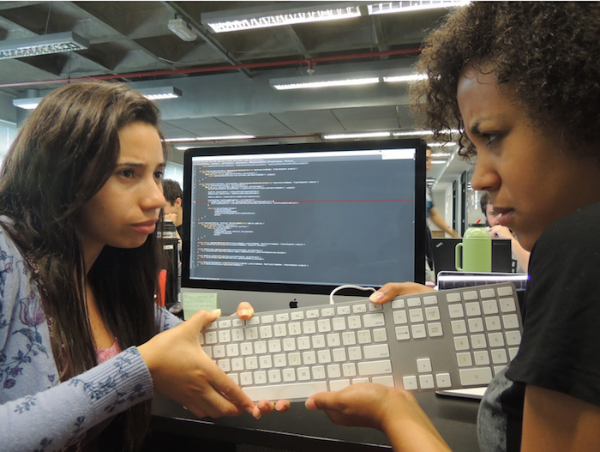
Test Driven
development
3.
Beware of… Complex setups
THOMAS PIERRAIN (@TPIERRAIN)
Notes:
Image: https://insights-images.thoughtworks.com/1020ways20pair20programming201_ac7561ab53c005c72dd42a76dcc238a9.png

Slide 56
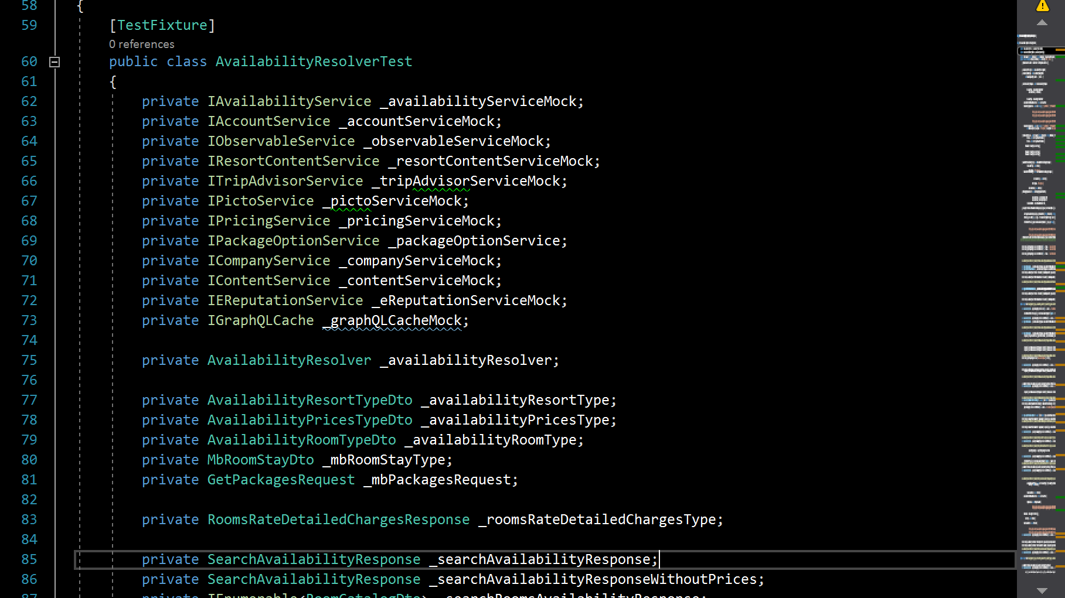
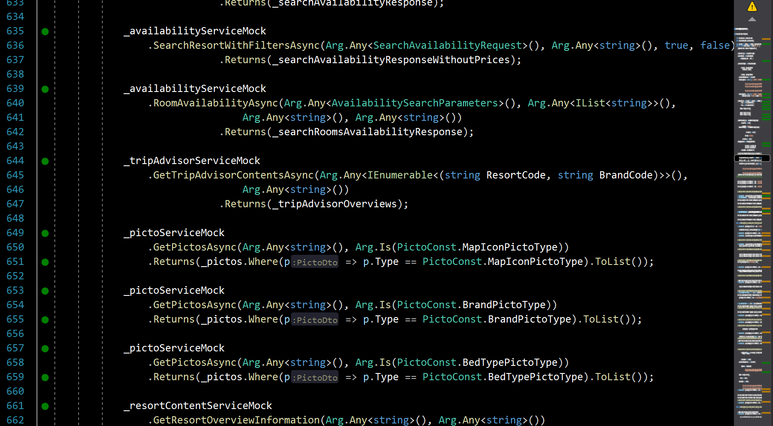
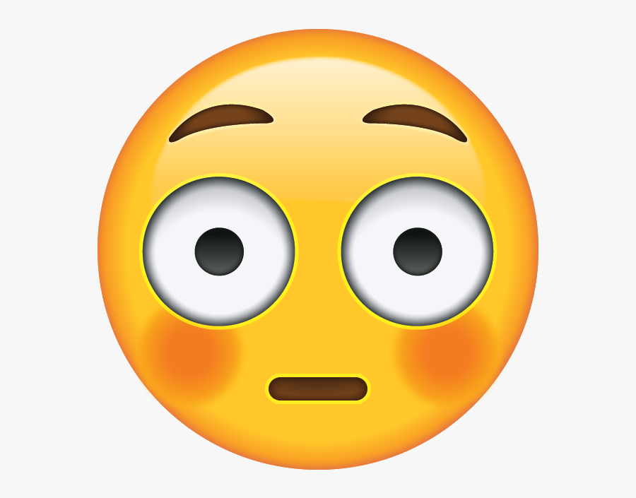
Test Driven
development
Test Suite for Rooms Availability
740 lines of Init()
3.
Beware of… Complex setups
THOMAS PIERRAIN (@TPIERRAIN)
Notes:
Image: https://insights-images.thoughtworks.com/1020ways20pair20programming201_ac7561ab53c005c72dd42a76dcc238a9.png

Slide 57
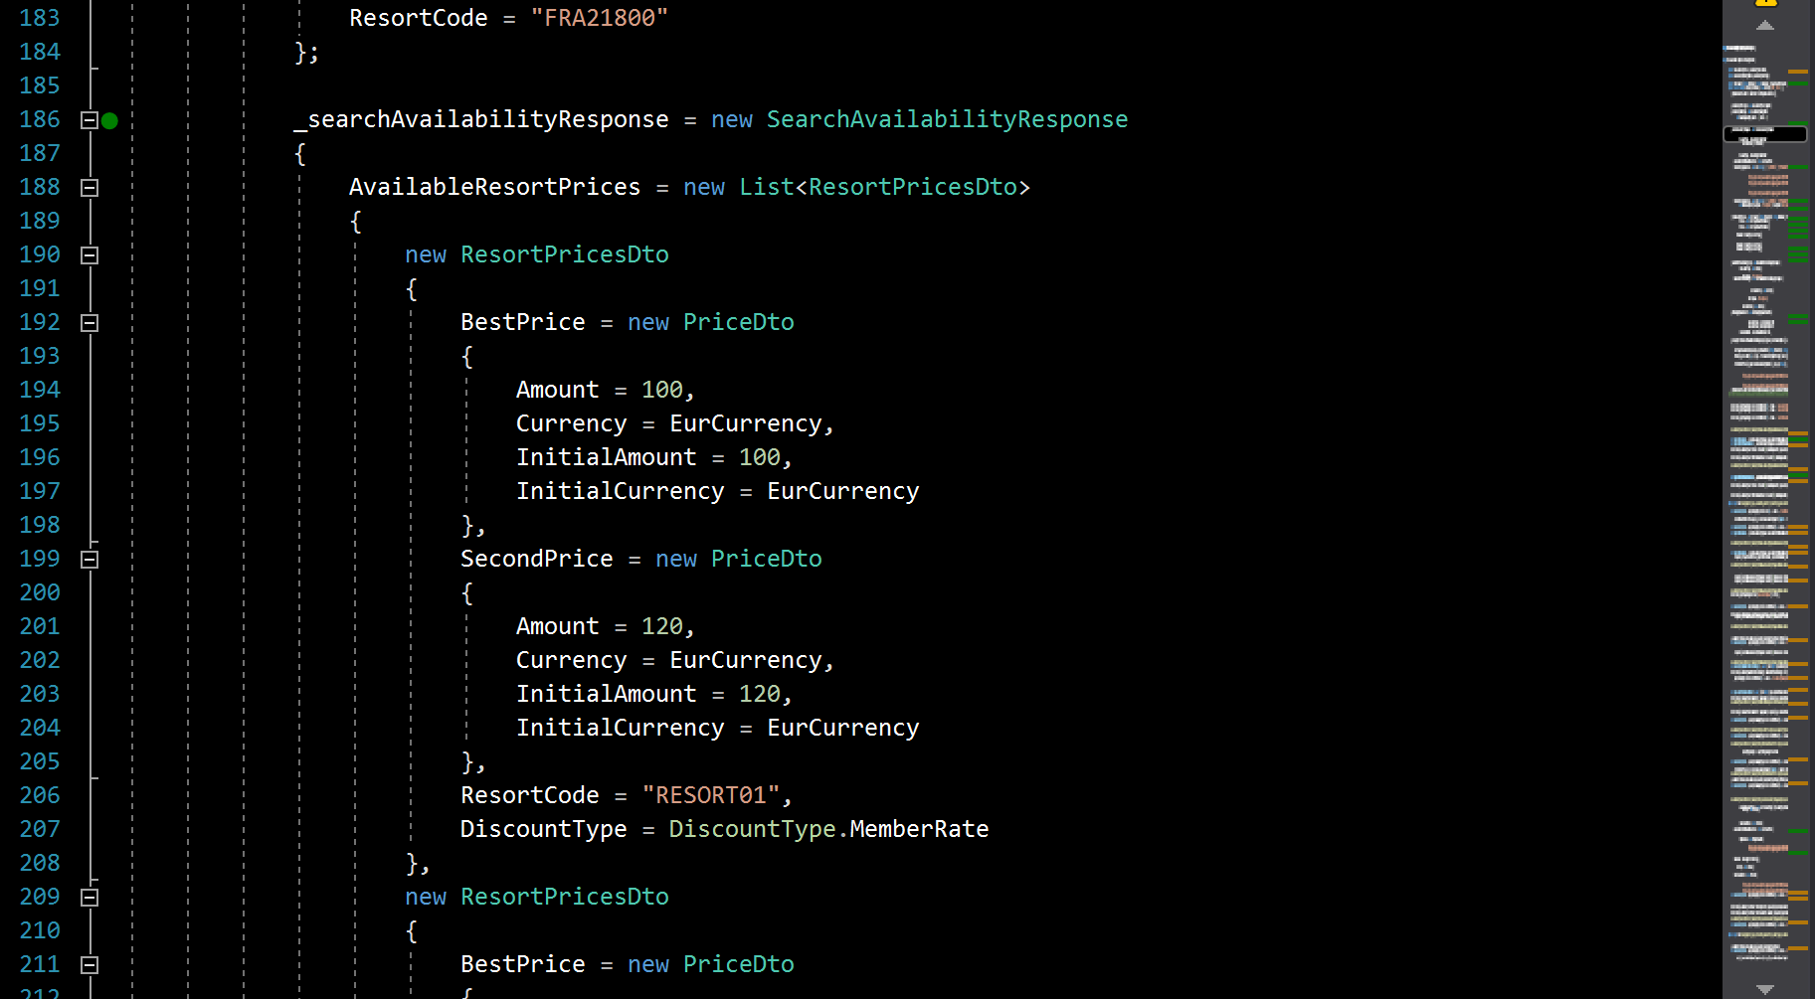
Test Driven
development
Test Suite for Rooms Availability
740 lines of Init()
3.
Beware of… Complex setups
THOMAS PIERRAIN (@TPIERRAIN)
Notes:
Image: https://insights-images.thoughtworks.com/1020ways20pair20programming201_ac7561ab53c005c72dd42a76dcc238a9.png

Slide 58
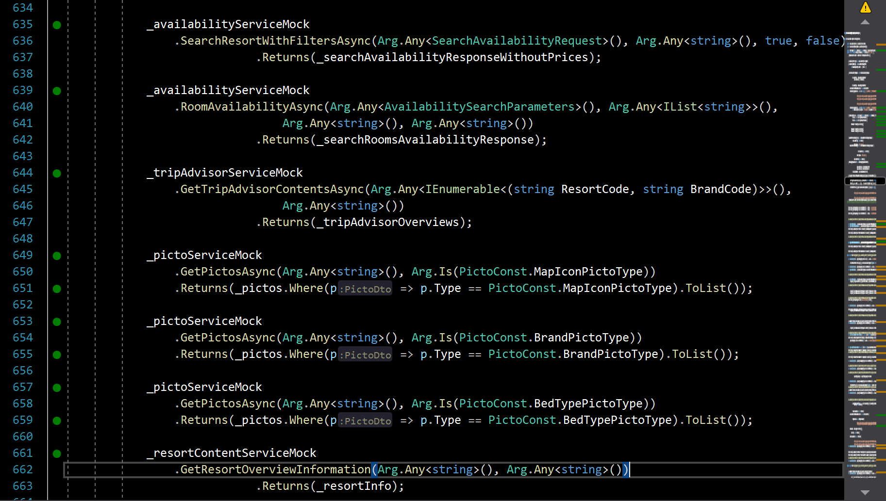
Test Driven
development
Test Suite for Rooms Availability
740 lines of Init()
3.
Beware of… Complex setups
THOMAS PIERRAIN (@TPIERRAIN)
Notes:
Image: https://insights-images.thoughtworks.com/1020ways20pair20programming201_ac7561ab53c005c72dd42a76dcc238a9.png

Slide 59
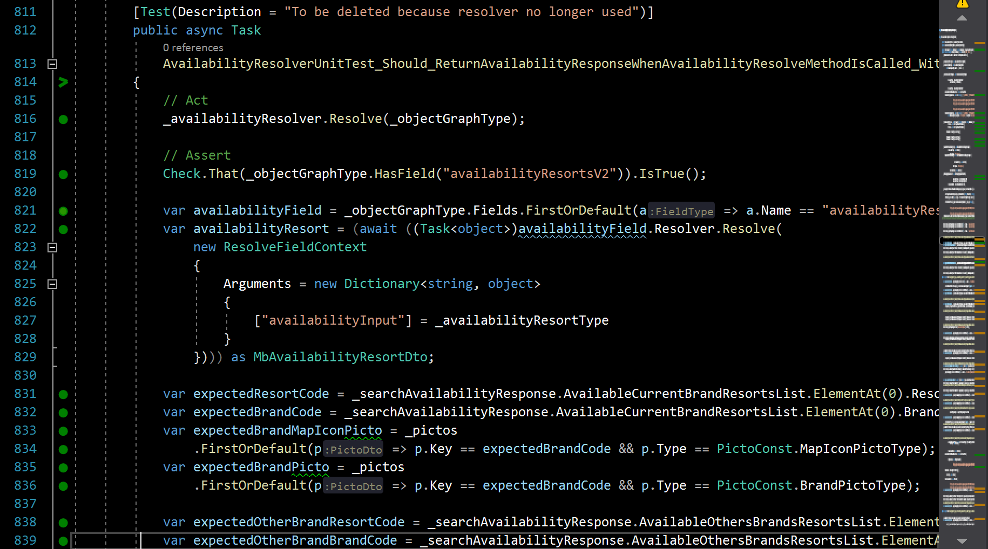

Test Driven
development
Test Suite for Rooms Availability
3.
Beware of… Complex setups
Tests using initialized fields ➔ side effects nightmare
THOMAS PIERRAIN (@TPIERRAIN)
Notes:
Image: https://insights-images.thoughtworks.com/1020ways20pair20programming201_ac7561ab53c005c72dd42a76dcc238a9.png

Slide 60

Test Driven
development
Mitigations
Avoid cognitive overload as much as possible The power of sameness
Favor local variables over test suite members Everything should be created from the test
Use Domain-Driven Builders to shorten and explicit the Arrange section of your tests
Treat your test code as production code! ➔ merciless refactoring
3.
Beware of… Complex setups
THOMAS PIERRAIN (@TPIERRAIN)
Notes:
Do not use field members, [Init], [Setup] … anything that is declared outside the test
Do not use test suites inheritance neither
Arrange – Act - Assert
Image: https://insights-images.thoughtworks.com/1020ways20pair20programming201_ac7561ab53c005c72dd42a76dcc238a9.png

Slide 61
Test Driven
development
1. Fragile tests
2. Blind spots
3. Complex setups
Beware of…
THOMAS PIERRAIN (@TPIERRAIN)
Notes:
Ok Let’s sum up all those pitfalls and risks while doing TDD. And for every one of them, the mitigations we’ve identified.
---------------------
Cognitive overload reduce stamina ➔ Pit of failure. Like a broken window syndrome.
https://www.welcometothejungle.com/en/articles/cognitive-overload-at-work
Image : https://encrypted-tbn0.gstatic.com/images?q=tbn:ANd9GcRUkEI7a62LZWV7URYcN5jClByl0GkP6ReZvA&usqp=CAU
I could have added
Non deterministic - The team must be confident in their tests
Slowness – The team must not wait more than 3-5 minutes to run all the tests

Slide 62
Test Driven
development
Do not test “implementation details”
Favor Acceptance tests (coarse-grained unit tests)
When we test Implementations instead of behaviours ; - (
1. Fragile tests
2. Blind spots
3. Complex setups
Mitigations
THOMAS PIERRAIN (@TPIERRAIN)
Notes:
First, the fragile tests. Basically, they are the consequence of badly written tests, tests that target too much the internal implementation of our components, implementation details.
Clic
So. First : do not test implementation details
And since it is easier to say than to do. Especially for beginners that stuggle a lot in order to write behaviour-driven tests with fine grained tests.
My trade-off was (see the second point here) to recommend to write more coarse grained acceptance tests, than the fine grained one.
Of course they are exceptions, but IT will take more time to explain and to discuss about it. Hence not for today (unless we have specific questions at the end of course).

Slide 63
Test Driven
development
Do not test “implementation details”
Favor Acceptance tests (coarse-grained unit tests)
When we test Implementations instead of behaviours ; - (
Because We tend to overlook some boring but crucial areas ( like adapters code )
Include the Adapters to your Acceptance tests
Test the adaptation in action
(All corner cases covered)
Stub only the I/O
(super fast tests)
1. Fragile tests
2. Blind spots
3. Complex setups
When ( Unit x Integration )
Test coverage is not enough
Mitigations
THOMAS PIERRAIN (@TPIERRAIN)
Notes:
Second issue : Blind spots in our global test harness (meaning the combination of fine grained unit tests, acceptance tests, integration/contract tests, and E2E tests in rare cases
As I could see in all the various missions, contexts, companies, teams I’d worked with: this is the consequence of a psychological bias: we, as dev, rather write domain-related tests that integration tests.
Clic
Hence the trade-off: Let’s include all these blind spots in our domain-driven Acceptance tests. Let’s test them in all our relevant actions for the business, and stub only the I/Os to keep our acceptance tests really fast. The coverage combination will be higher and the team will feel more confident with that setup (too bad for the cargo-cult coaches that still continue to think they can easily change the people and the culture instead of adapting their practices). I’ve met tons of them in my career.
“One should not do this…”, “one must not do that”…. And when your are asking why? Akward silences, before dogmatic answers.
In my opinion, our practices must remain alive, adaptable to various contexts. Anyway!

Slide 64
Test Driven
development
Do not test “implementation details”
Favor Acceptance tests (coarse-grained unit tests)
When we test Implementations instead of behaviours ; - (
Because We tend to overlook some boring but crucial areas ( like adapters code )
Include the Adapters to your Acceptance tests
Test the adaptation in action
(All corner cases covered)
Stub only the I/O
(super fast tests)
1. Fragile tests
2. Blind spots
3. Complex setups
When ( Unit x Integration )
Test coverage is not enough
Mitigations
Use Domain-Driven Builders to shorten and explicit the Arrange section of your tests
THOMAS PIERRAIN (@TPIERRAIN)
cognitive overload reduces stamina
and engagement
Notes:
Third kind of issues: complex test code, complex setups that reduce our stamina and disengage people day after day.
Clic
The trade-off is to simplify our test code and test setups, to include all the setup part in every acceptance test (to prevent from declaring stuffs elsewhere, far away in private members or fields in our test suites), but to shorten the arrange sections, the setup section of our tests with Builders.
And Domain-driven builders! talking with the language of the domain, and about concerns of the domain. Not technical concerns nor stub configuration details.
But it’s probably time for me to tell you more about all these trade-offs combined leading to the style we’ve called: Outside-in Diamond TDD!

Slide 65
Outside-in Diamond TDD
Trade offs made in reaction to people’s behaviors
(observed around me over and over and over again)
Notes:
(slowly) Outside-in Diamond TDD
Clic
Yes. Outside-in Diamond TDD is the result of some trade offs made in reaction to people’s behaviours.
It’s the consequence of many observations of people here and there in our teams and companies, and customers … over, over, and overs again.

Slide 66
Outside-in Diamond TDD
For the overall workflow we favor
For the kind of tests we favor the most
Notes:
The first part: outside in, is related to the overall workflow we favor.
Clic
The second part : Diamond is related to the kind of tests we suggest to do more: the components/the acceptance tests that are coarse grained unit tests.

Slide 67
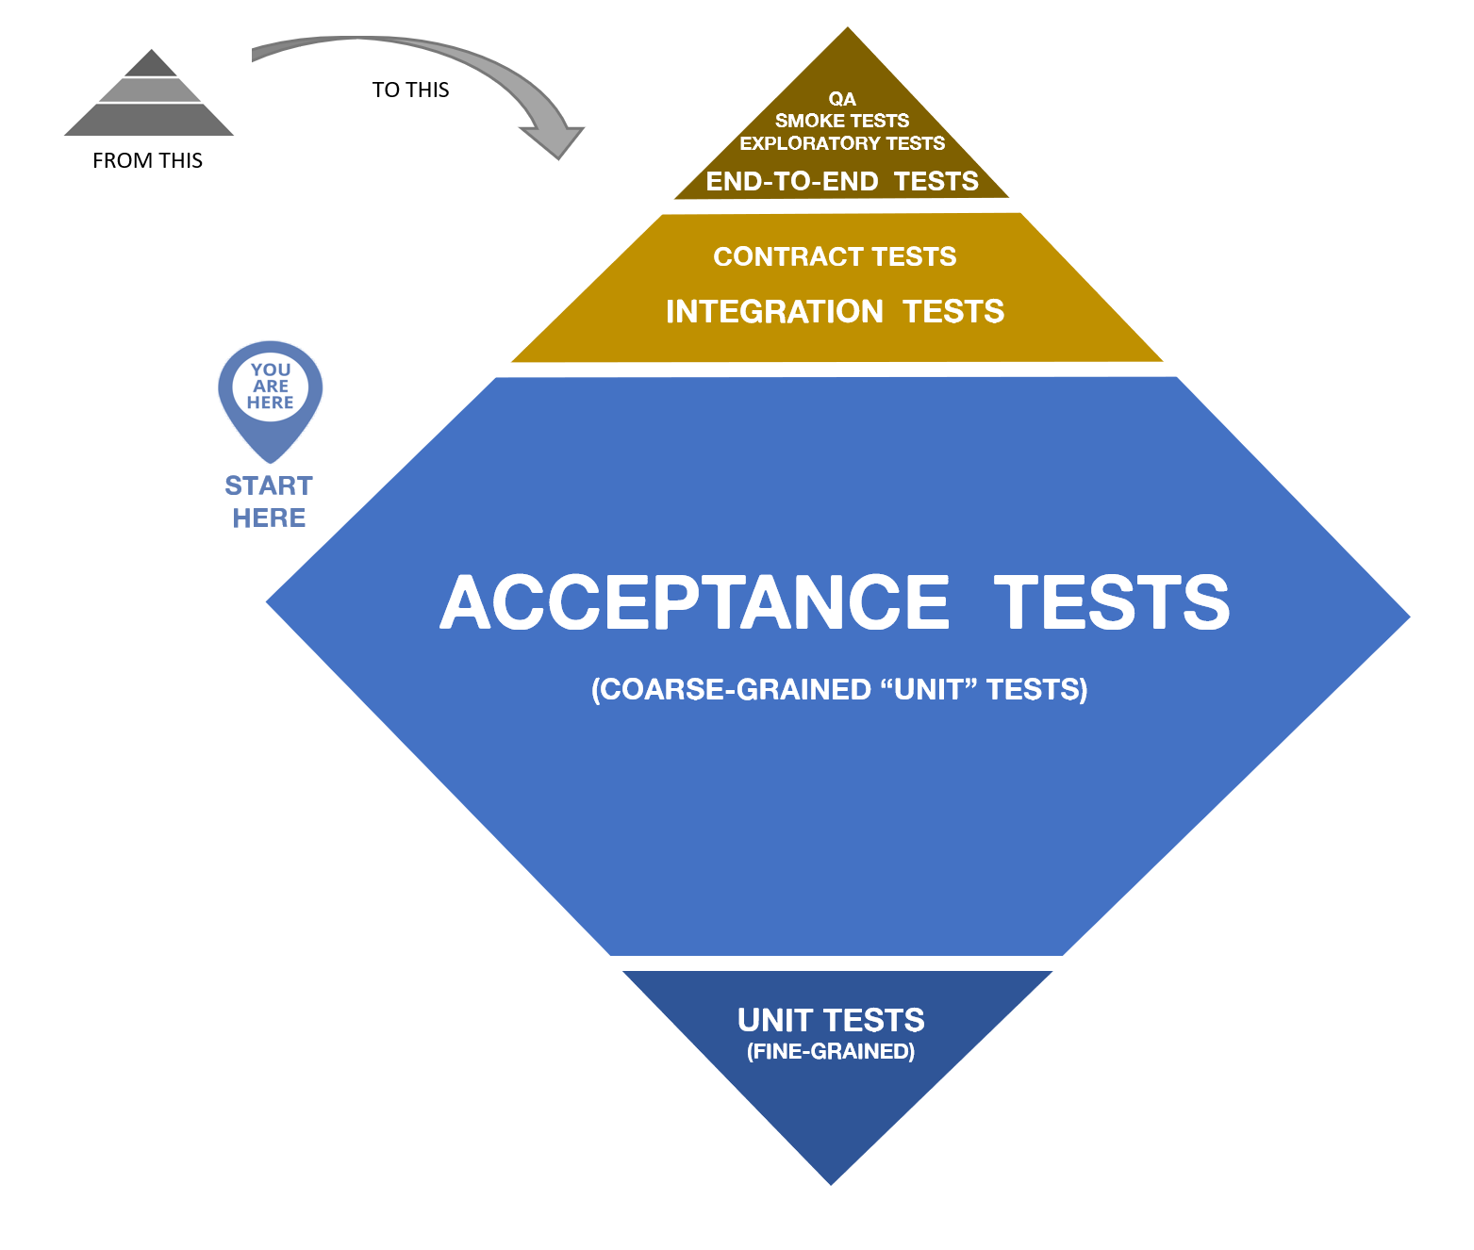
Outside-in Diamond TDD
For the overall workflow we favour
For the kind of tests we favour the most
Notes:
This is a direct reference to the test pyramid that I really don’t think was useful in the various context I worked with.
Every time, like with the word : “unit test”, it was error-prone and confusing for people (and even more experienced ones). IMO this testing pyramid –even if the idea of it is to be the starting point of a discussion about our test strategy- this pyramid should definitely be delivered with an experienced tech lead or coach aside ;-)
Anyway, we though that the diamond fits better to express the fact that we trade off to write more coase-grained acceptance tests than fine grained unit tests.
This is where comes from the diamond thing.
Actually, Outside-in Diamond TDD is a style of doing TDD. A specific workflow (mainly outside-in), a kind of double loop between the coarse grained loop and the fine grained loop, and some specificities about how to write our tests. We will see that in a couple of seconds.

Slide 68

Test Driven
development
Double loop?
Outside-in but…
THOMAS PIERRAIN (@TPIERRAIN)
Notes:
But before we have-a-look-at-the-code, let’s just focus one sec on the workflow: The way and the pace we use to write our tests.
Here I wrote “Double loop” with a question mark, because my version is slightly different than the classical “double loop”

Slide 69
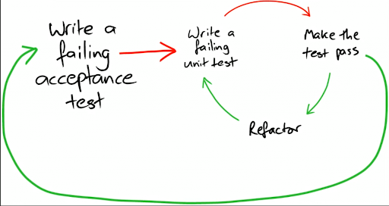
Test Driven
development
Double loop
Outside-in but…
THOMAS PIERRAIN (@TPIERRAIN)
Notes:
Here is the classic version of the double-loop.
You write a failing acceptance test towards your black-box/your system/your component/your future API whatever…
You try to make it pass by starting the implementation of the inside of your black-box, and to do so, you will start writing a fine grained unit test (then you start the inner loop with its RED-GREEN-REFACTOR, RED-GREEN-REFACTOR, RED-GREEN-REFACTOR…) until you make the original acceptance test pass. In other word, you made it green. Then…
You can refactor whatever you want or need to refactor (for instance, you improve your acceptance test code). And…
You write another acceptance test in the outer loop, before you continue within the inner loop by writing the fine-grained unit test you need to continue to implement it.
Ok?

Slide 70
Test Driven
development
(
)
Double loop
One and a half loop
Outside-in but…
THOMAS PIERRAIN (@TPIERRAIN)
Notes:
Will still have debates about it with my associate Bruno BOUCARD (which is a hell of a tech coach) but…
My version is pretty much not a double loop anymore. It’s rather something like a “One-and-a-half-loop” ;-)
It means that I do not always write fine grained unit tests, it will depend on the context and the situation. In other word: every time I face a difficulty, or every time as a pair or as a mob we think it worth to jump into that inner loop => we do it.
But there is a huge disclaimer with this:
I can do this because I’m practicing TDD at work since more than fifteen years.
We can do this with my mates because we have lots of discussions with the domain experts or domain proxy. Even if our understanding and our code will continue to evolve day after day (renaming things on the fly whenever we can), We already have some kind of shared mental model of what to do, and we discuss also a lot on how to do it (with strong style pairing where the one having the idea is not the one having the keyboard )
But when I’m coaching or teaching TDD to beginners, we do a real double loop.
Ok! That’s it for the workflow. Let’s see how our acceptance tests look like!

Slide 71
Testing strategy
By-the-book tests of HEXAGONAL ARCHITECTURE
Outside-In Diamond tests of HEXAGONAL ARCHITECTURE
AT
AT
AT
AT
AT
AT
AT
Domain
AT
AT
AT
AT
AT
AT
AT
AT
AT
(GraphQL) BookingResolver Adapter
Domain
Domain
Stub
ResortContent Service Adapter
Stub
Stub
Picto Service Adapter
Stub
Stub
Stub
Resort Service Adapter
Booking Service Adapter
Stub
Stub
Ports Last-miles stubs
⚠️
Not supported by Alistair
Notes:
Image : https://insights-images.thoughtworks.com/pairprogramming_f0d3ae7ef121e981e150bfcae4ecb995.jpg

Slide 72
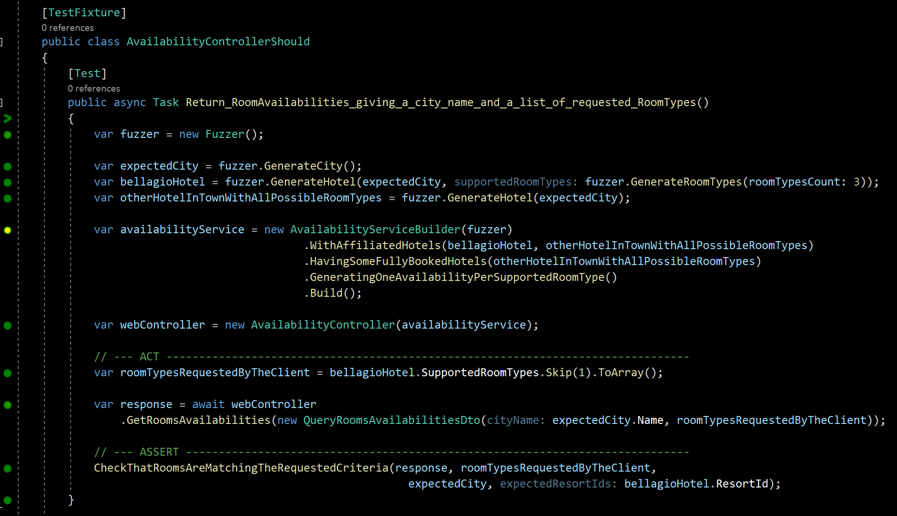
Outside-in diamond
Notes:
Silence. It’s alright if you can’t see the code right now, because I will help you to navigate with me line after line.

Slide 73
Outside-in diamond
Notes:
It all start with a test suite, here a test fixture in C# (with Nunit)

Slide 74
Outside-in diamond
+
Read it as a sentence divided into 2 parts
Notes:
An important step is to know what we want our system to do. To find a test name.
And here, I’m following the “should” convention. I think first time I’ve seen that was from Sandro Mancuso in London.
So. (pause) read it like a sentence starting at the test suite name (AvailabilityControllerShould) followed by the name of the test method. here:
“Return room availailabilities giving a city name and a list of requested room types()
A room type is something like : standard room, double room, family suite etc.

Slide 75
Outside-in diamond
Fuzzers help us - to randomly detect hard-coded values or unsupported cases
Notes:
Then we use fuzzers of random values generators. Here with the Diverse library for .Net
Fuzzers helps us to :
- Randomly detect hard-coded values or unsupported cases

Slide 76
Outside-in diamond
Fuzzers help us - to randomly detect hard-coded values or unsupported case
- to shorten our test setup
Notes:
But they also help us to shorten our test setup, the arrange part of the test.
For instance here in 1 line only, I can create a specification for an hotel, the Bellagio hotel, and specify the RoomTypes it must have
(here, the GenerateRoomTypes method allows us to randomly pick 3 different room types from my domain possible values)

Slide 77
Outside-in diamond
Builders allow Behavioral & Domain-Driven intentions (no tech details here)
Notes:
Then we use to rely on builders (see the builder pattern) in order to declare what we need to setup for this test.
These builders must be Domain-driven (in other words, they are using the ubiquitous language of our domain experts in order to express domain intentions only. Not technical)
How does it look like? Here, we want…

Slide 78
Outside-in diamond
Builders allow Behavioral & Domain-Driven intentions (no tech details here)
Notes:
To work with 2 affiliated hotels. I’m working for an international group having tons of hotels from various brands and policies etc.
The 2 hotels are described via the hotel specifications I’ve created just before with my fuzzer: the Bellagio hotel variable and the other-Hotel-in-town-with-all-possible-room-types.)

Slide 79
Outside-in diamond
Builders allow Behavioral & Domain-Driven intentions (no tech details here)
Notes:
Then I explain to my builder that I would like to have one fully-booked hotel (the one named “otherHotelInTownWithAllPossibleRoomTypes”).
Hence I will be able to check after, that no availability must be suggested from this fully booked hotel (we should only have availabilities from the available hotels, here the Bellagio hotel)

Slide 80
Outside-in diamond
Builders allow Behavioral & Domain-Driven intentions (no tech details here)
Notes:
Then we ask our builder to setup all the stubs/test doubles/etc we need for this test so that we simulate a situation where we should have “1 availability per supported room type for every hotel”
One room available for every room types supported by the various hotels. Of course, not if they are already fully booked.

Slide 81
Outside-in diamond
Builders allow Behavioral & Domain-Driven intentions (no tech details here)
Notes:
And finally we build our Availability service. The one that is doing the domain logic,
The “availability service” that exposes and implement a left-side port (of our hexagonal architecture for instance).
This portion of domain logic that we will inject to our web controller (the wb controller being our left-side adapter).

Slide 82
Outside-in diamond
Very important!
Builders allow Behavioral & Domain-Driven intentions (no tech details here)
Notes:
…Very important for both our future refactorings but also for the sake of readability:
We should never, ever, never ;-) put some technical details in our builder domain specific language. Only domain-driven intentions and expected behaviours.
One should not talking about stubs and stubbing details here, on the public side of the builder. But of course, the Build() method internally, will instantiates our various stubs whenever needed (internally using some substitute libraries like Nsubstitute, or Mockito in Java or… whatever your platform, you should find it).

Slide 83
Outside-in diamond
Injecting the result of our builder
We test from the left-side Adapter (here a web controller)
Notes:
Then we can instantiate our subject under test (the SUT), which is the AvailabilityController (web controller variable)
Because targeting the web controller level in our test, helps us to cover all its adapting code. And remember, we don’t test the network here! Only the adaptation code (from JSON, DTOs to domain one and vice versa when we need our API to return an answer)
Click (next slide)
Here we inject the result of our builder to this web controller (left side adapter)

Slide 84
Outside-in diamond
We define the end-user request
No I/O here, but we test the whole { black-box / component / API }
Notes:
We then define the end-user request. Here something like: “as a customer, I want to know what availability you will have for me and a bunch of room types (e.g.: Single room, double room, family suite etc)”
Click (next animation)
Important here: no network, no I/O. Even if we want to test the full black box, our API, our component. We want our Acceptance tests to be as fast as possible (between 5 and 200 milliseconds max for every acceptance test).

Slide 85
Outside-in diamond
Helper method to sum-up in “one line” our assert intention
Notes:
Last but not least: the assertion.
Instead of exposing all the DTOs and checks on our technical types for the answer, we hide them behind a one-liner Domain-driven intention.
A private private test or extension method.
The CheckThatRoomsAreMatchingTheRequestedCriteria method of my test suite, my test fixture.

Slide 86
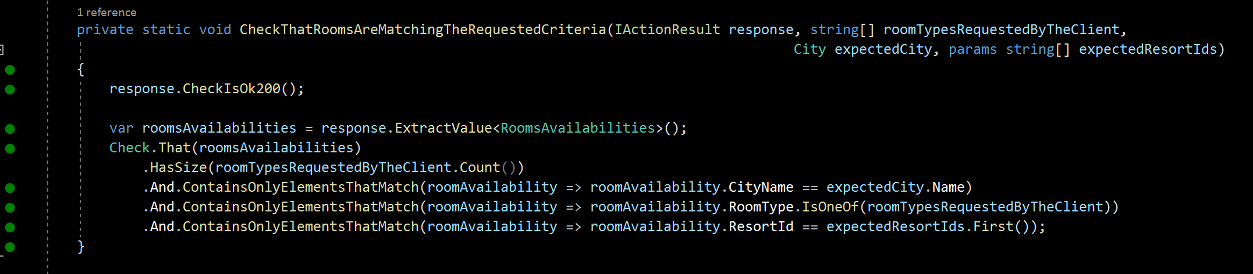
Outside-in diamond
“One line” to hide our technical assertions towards DTOs etc.
Notes:
This one-line invocation help us to hide the checking implementation.
Here we can hide the fact that we are checking the kind of HttpResponse we are supposed to get (here 200 http status code)
It also helps us to hide all the checks/assertions we make on the DTO returned by our web controller as the answer.

Slide 87
Outside-in diamond
“One line” to hide our technical assertions towards DTOs etc.
“One line” to reuse the same check intention, but with various adapters
Notes:
Having this private helper method that encapsulates all the infrastructure details behind it… has also a very interesting side-effect…
Click
=> It allows us to reuse the very same assertion intention (expressed in the domain language), so that we can implement it differently if we have different left-side adapters (if we have this requirement).
I mean: the requirement of having to switch the exposition models and technologies for your service (either through a web API, a message-oriented bus, etc. But on my side, we usually exposes our services through web APIs. So…)
But once again, “encapsulate change” (from the OOP world) is a good advice.

Slide 88
Outside-in diamond
Notes:
Ok. To sum-up

Slide 89
Outside-in diamond
Notes:
First we have the Arrange part of the test. Should not take more than 8-10 lines

Slide 90
Outside-in diamond
Notes:
Then we have the “ACT” section of our test which is targeting left-side adapters (here a web controller).
2 lines here
One can even hide the DTO declaration behind a single test private method that will do the job.
It can be really helpful for people having to test more than one left side adapter as we just mentioned earlier in the previous slide.
So Action between 1 or 2 lines

Slide 91
Outside-in diamond
Notes:
And finally we have the Assert section of our Acceptance test.
Here: 1 line
And then here again, you can “eat your cake and have it too” (meaning: you can have a Domain-driven assertion without any specific details about your DTOs and infrastructure adaptations, but nonetheless testing them in order to avoid bugs in production related to any kind of Adapters).
To do so, all you have to is to hide our assertions behind a private method that will express your assert intention. Here I could have found a better example of a domain-driven name... but I hope you can get my point.

Slide 92
Outside-in diamond
Notes:
Here is the full test

Slide 93
Outside-in diamond
Arrange
ACT
Assert
Notes:
With its 3 A-A-A sections highlighted :
ARRANGE
Click
ACT
=> Click
ASSERT

Slide 94
Outside-in diamond
Fuzzers to shorten & speed setup
Arrange
Builders to shorten and “domain-driven” our test setup
ACT
Assert
Notes:
And 2 things to keep in mind: use fuzzers & use builders
They will allow you to:
shorten your tests
speed up their writing
improve your bug detection
Make them less fragile, because less connected to your implementation
Foster Domain-driven expressivity

Slide 95
Outside-in diamond
Domain-Driven!
Notes:
And 2 things to keep in mind: use fuzzers & use builders
They will allow you to:
shorten your tests
speed up their writing
improve your bug detection
Make them less fragile, because less connected to your implementation
Foster Domain-driven expressivity

Slide 96
Live code

Slide 97
Wrap up
Notes:
Ok, final wrap-up!

Slide 98
Outside-in Diamond TDD
Thomas PIERRAIN @tpierrain (υѕe caѕe drιven)
Elaborated from & for the people
Write fast & Antifragile tests ( refactoring )
DDD but covers more blind spots on the tech side
Notes:
To conclude
Clic
It has been elaborated from and for the people we were working with during the last decade or so. ➔ clic
It allows us to write fast and antifragile tests. Meaning: tests that fully embrace your merciless refactoring sessions. You need to change something in your implementation? The impact will stay at the builder level, in factorized code. It’s very unlikely that you need to change lots of tests. ➔ clic
It Allows us to fully embrace Domain Driven Design (especially the ubiquitous language part) in our tests, but – and it’s a key point: it allows us to catch lots of tiny bugs that are located in boaring code (the one doing the adaptations in all our possible combination) ➔ the left and right-side Adapters of our hexagonal architecture APIs
➔ clic

Slide 99
Outside-in Diamond TDD
Thomas PIERRAIN @tpierrain (υѕe caѕe drιven)
Elaborated from & for the people
Write fast & Antifragile tests ( refactoring )
DDD but covers more blind spots on the tech side
Notes:
So I would love to have your feedback and questions about it. Right now. But also through twitter where you can reach me with the twitter handle here on screen
It’s just the beginning for me to talk about this topic. I will continue to explain what it is in the upcoming weeks through real live coding sessions this time, and maybe videos in order to clarify the whole process, the workflow, the decisions, the design, etc.

Slide 100
Any Questions?
Notes:
Ok. Do we still have some time for some questions?
Do you have any questions?
I don’t know how Oliver and Cherif would like to do this. But I’m ok to continue to discuss it about it if it’s possible for you.
---------------------------------
Common objections
Combinatory explosion of test cases?!? ➔lots of concise & easy to write acceptance tests (powered by fuzzers) were more than sufficient in 85% of my experience
Surgical identification of bug spots?!? ➔ no big deal actually. very episodically, You just debug your reproductible acceptance test and… TADA! (this point was just cargo-cult psychological barrier)

Slide 101
Binary is for machine Code is for people We care people
Special thanks to: Bruno BOUCARD, Cyrille DUPUYDAUBY & Rui CARVALHO for their kind reviews & feedbacks

Slide 102
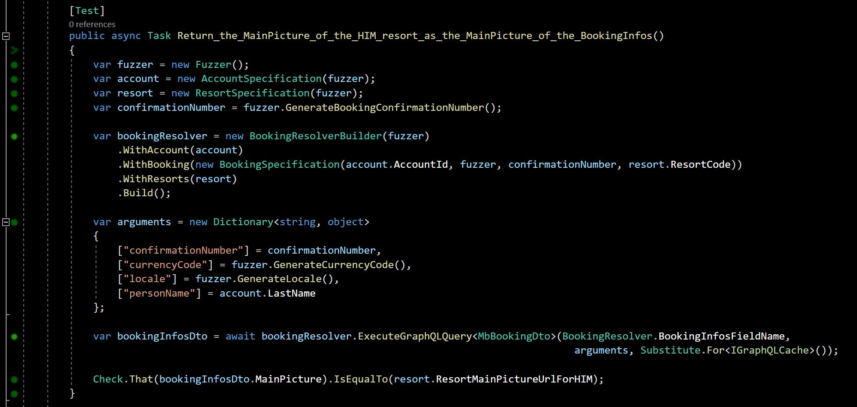
Outside-in Diamond TDD With hexagonal architecture
The infra code (i.e. Adapters) is also covered by our { acceptance | unit tests }
Tests
AT
AT
AT
AT
AT
AT
AT
(GraphQL) BookingResolver Adapter
#outsideInDiamond
Domain
Domain
ResortContent Service Adapter
Fuzzers & Specification objects
to ease test setup & explore more
Stub
Picto Service Adapter
Builders to shorten and
“domain-driven” our hexagonal setup
for testing
Stub
Resort Service Adapter
Booking Service Adapter
Stub
THOMAS PIERRAIN (@TPIERRAIN)
Stub
We only stub I/Os
Notes:
Image : https://insights-images.thoughtworks.com/pairprogramming_f0d3ae7ef121e981e150bfcae4ecb995.jpg

Slide 103
How by-the-book people do test
Adapters aren’t covered by their { acceptance | unit tests }
AT
AT
AT
AT
AT
AT
AT
AT
Domain
Domain
Stub
HTTP
API
Stub
Right Adapter
80%
HEXAGONAL ARCHITECTURE
BUG
IT
Stub
IT
Stub
IT
Integration tests
THOMAS PIERRAIN (@TPIERRAIN)
HTTP
API
Adapters are covered by their { integration tests }
Right Adapter
IT
60 %
IT
IT
BUG
Integration tests
Notes:
s

Slide 104
Outside-In Diamond
Most of the infra code (i.e. Adapters) is also covered by our { acceptance | unit tests }
AT
AT
AT
AT
AT
AT
AT
AT
(GraphQL) BookingResolver Adapter
Domain
Domain
ResortContent Service Adapter
Stub
Picto Service Adapter
the HEXAGONAL ARCHITECTURE case
Stub
Resort Service Adapter
Booking Service Adapter
Stub
THOMAS PIERRAIN (@TPIERRAIN)
Stub
⚠️
We only stub I/Os
Notes:
Image : https://insights-images.thoughtworks.com/pairprogramming_f0d3ae7ef121e981e150bfcae4ecb995.jpg

Slide 105
Outside-In Diamond
Most of the infra code (i.e. Adapters) is also covered by our { acceptance | unit tests }
AT
AT
AT
AT
AT
AT
AT
AT
(GraphQL) BookingResolver Adapter
Domain
Domain
ResortContent Service Adapter
Stub
Contract tests aside to ensure that our stubs are faithful to reality
Picto Service Adapter
the HEXAGONAL ARCHITECTURE case
Stub
Resort Service Adapter
HTTP
API
Booking Service Adapter
Right Adapter
80%
Stub
THOMAS PIERRAIN (@TPIERRAIN)
IT
Stub
IT
IT
⬄
IT
⚠️
We only stub I/Os
Contract tests
Adapter
Stub
Notes:
Image : https://insights-images.thoughtworks.com/pairprogramming_f0d3ae7ef121e981e150bfcae4ecb995.jpg

Slide 106
Outside-In Diamond
Most of the infra code (i.e. Adapters) is also covered by our { acceptance | unit tests }
AT
AT
AT
AT
AT
AT
AT
AT
(GraphQL) BookingResolver Adapter
85 % (running all day long)
Domain
Domain
ResortContent Service Adapter
Stub
Contract tests aside to ensure that our stubs are faithful to reality
Picto Service Adapter
the HEXAGONAL ARCHITECTURE case
Stub
15 % (running nightly)
Resort Service Adapter
HTTP
API
Booking Service Adapter
Right Adapter
80%
Stub
THOMAS PIERRAIN (@TPIERRAIN)
IT
Stub
IT
IT
⬄
IT
⚠️
We only stub I/Os
Contract tests
Adapter
Stub
Notes:
Image : https://insights-images.thoughtworks.com/pairprogramming_f0d3ae7ef121e981e150bfcae4ecb995.jpg

Slide 107
Outside-In Diamond
Most of the infra code (i.e. Adapters) is also covered by our { acceptance | unit tests }
AT
AT
AT
AT
AT
AT
AT
AT
(GraphQL) BookingResolver Adapter
Domain
Domain
ResortContent Service Adapter
Stub
Contract tests aside to ensure that our stubs are faithful to reality
Picto Service Adapter
the HEXAGONAL ARCHITECTURE case
Not supported by Alistair!
Stub
Resort Service Adapter
⚠️
HTTP
API
Booking Service Adapter
Right Adapter
80%
Stub
THOMAS PIERRAIN (@TPIERRAIN)
IT
Stub
IT
IT
⬄
IT
⚠️
We only stub I/Os
Contract tests
Adapter
Stub
Notes:
Image : https://insights-images.thoughtworks.com/pairprogramming_f0d3ae7ef121e981e150bfcae4ecb995.jpg

Slide 108
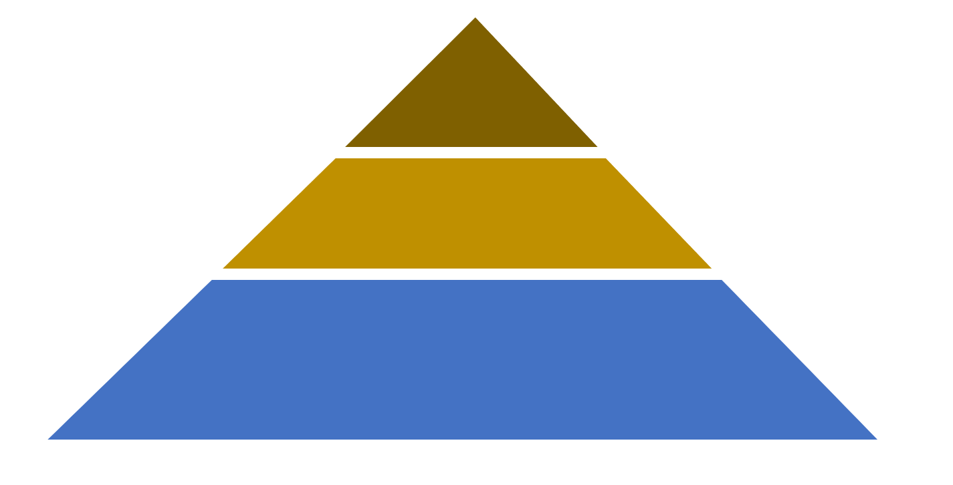



Checking In real life…
All real systems involved May be Manual sometimes
To this
QA
Smoke tests Exploratory tests End-to-end tests
From this
contract tests
Integration tests
Are we still compliant with…?
Some real systems involved
Ensure that Stubs ⬄ Real systems
It all starts here…
Outside-in TDD
Behavioural & Domain-Driven
Bloody Fast
Autonomous & Concise (builders & Fuzzers to setup)
NO I/O ➔ “last miles” stubs
Deterministic & Isolated
The outer loop
Start Here
Acceptance tests
(Coarse-grained “unit” tests)
unit tests
(Fine-grained)
For complex parts only
Behavioural & Domain-Driven
Bloody Fast
Deterministic & Isolated
The inner (optional) loop
testing gem: Why outside-in diamond is now our favorite testing strategy @

Slide 109
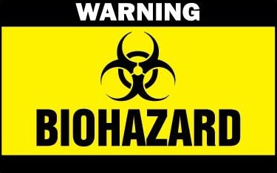
More integration
slower
UI tests
Service tests
unit tests
More isolation
Faster

Slide 110
Checking In real life…
All real systems involved May be Manual sometimes
To this
QA
Smoke tests Exploratory tests End-to-end tests
From this
contract tests
Integration tests
Are we still compliant with…?
Some real systems involved
Ensure that Stubs ⬄ Real systems
It all starts here…
Outside-in TDD
Behavioural & Domain-Driven
Bloody Fast
Autonomous & Concise (builders & Fuzzers to setup)
NO I/O ➔ “last miles” stubs
Deterministic & Isolated
The outer loop
Start Here
Acceptance tests
(Coarse-grained “unit” tests)
unit tests
(Fine-grained)
For complex parts only
Behavioural & Domain-Driven
Bloody Fast
Deterministic & Isolated
The inner (optional) loop
testing gem: Why outside-in diamond is now our favorite testing strategy @

Slide 111
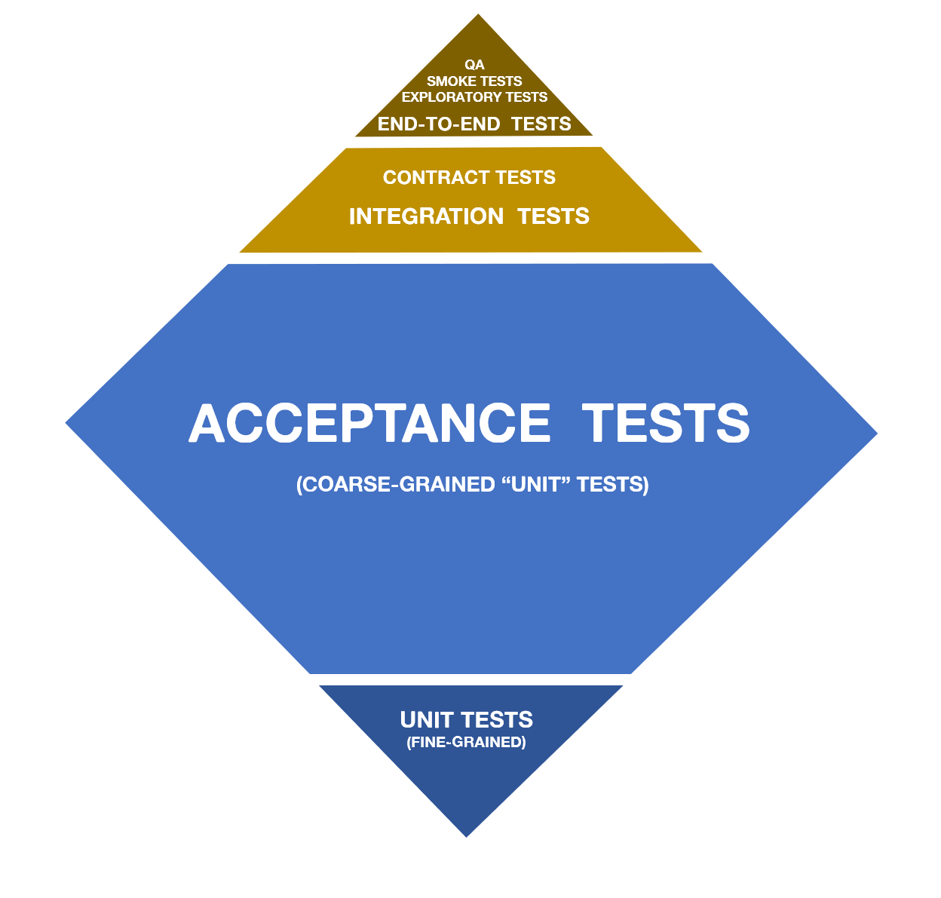
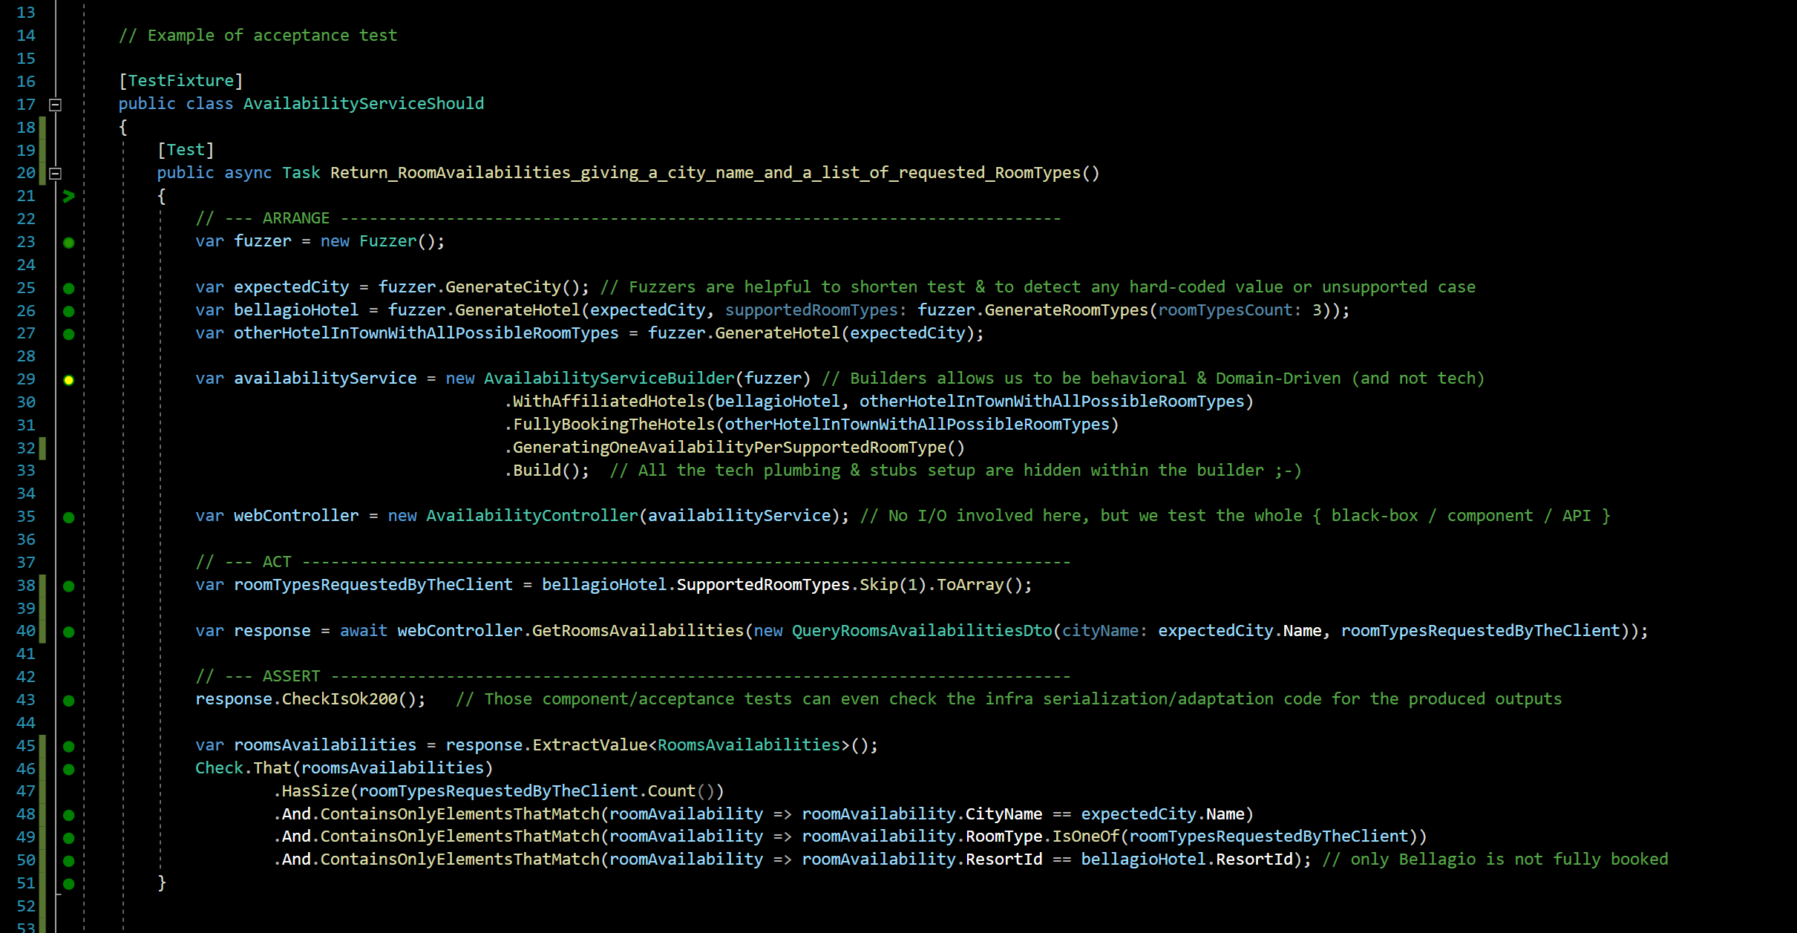
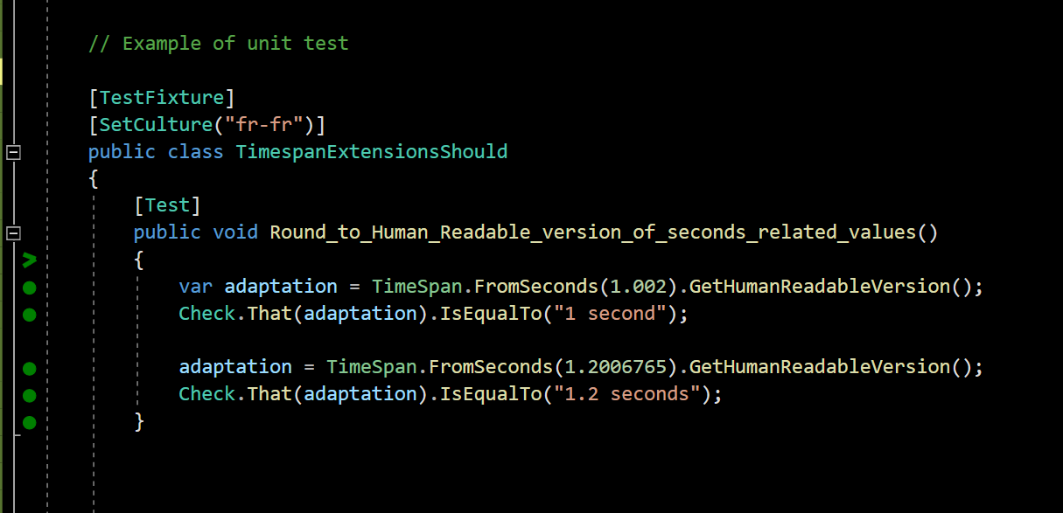
Can you Give me an example?
testing gem: Why outside-in diamond is now our favorite testing strategy @

Slide 112
What you test is what you ship…
No more bad surprises in situation >> everything is tested assembled
no more code plumbing leaks >> Our Acceptance tests cover everything (but I/O)
complementary contract (integration) tests >> A guarantee that the stubs we use to speed our Acceptance tests are faithful to reality
WHY
Easier for Junior DEVs
They are More focused on the system behaviors >> it Enforces Yagni
They code less fragile tests (no more implementation tests) >> it Eases merciless Refactoring
How
Specific Outside-in TDD
Double loop ➔ one and a half loop instead (Fine-grained unit tests only whenever facing difficulties)
Still Baby steps FTW!
only the external systems are stubbed
Acceptance tests cover adapters code too! (only the adaptation code in action, not its I/O)
Behavioural and domain-driven tests (DDD Ubiquitous language)
Blazing-fast acceptance tests
But…
…What about
Combinatory explosion of test cases?!? ➔lots of concise & easy to write acceptance tests (powered by fuzzers) were more than sufficient in 85% of our xp
Surgical identification of bug spots?!? ➔ no big deal actually. very episodically, You just debug your reproductible acceptance test and… TADA! (this point was just cargo-cult psychological barrier)
Friendly patterns & tools
DDD & Hexagonal architecture
Builders & Fuzzers for acceptance tests setup
live-testing tools
Dev people dislike to write enough integration tests (vs. unit ones). This explains lots of Blind Spots & Failures of classical test strategies
➔ We've tradeoff former approaches (UT x IT) in favor of safeness in production whatever the vigilance of the dev team
testing gem: Why outside-in diamond is now our favorite testing strategy @
Notes:
Blind spots of lots of test strategies is due to the fact that dev doesn’t take lot of time to code integration tests (vs. unit ones)
We trade off former approaches (UT x IT) in favor of quietness in production whatever the dev team.
Realizing that We realized that dev took more time to unit test than to integration tests
Dev dedicate a lot more times to unit test than integration tests

Slide 114
Test Driven
development
1. Fragile tests
2. Blind spots
3. Complex setups
Title here
THOMAS PIERRAIN (@TPIERRAIN)

Slide 115
Notes:
Image: https://miro.medium.com/max/7788/1*0aU36QSwzY0no7XEjoyM7g.jpeg

Slide 116
Notes:
Image: https://insights-images.thoughtworks.com/1020ways20pair20programming201_ac7561ab53c005c72dd42a76dcc238a9.png

Slide 117
Outside-in?
Test Driven
development
AT
AT
UT
UT
AT
AT
API
AT
UT
THOMAS PIERRAIN (@TPIERRAIN)
UT
Notes:
Image: https://miro.medium.com/max/13440/1*o7WmwGkLVR0dVQUYqfSBeg.jpeg

Slide 118
Test Driven
development
AT
AT
AT
AT
AT
AT
AT
AT
AT
AT
AT
AT
Domain
AT
AT
AT
100% covered
by Acceptance Tests
2.
Beware of… Blind Spots
Stub
BUG
IT
Right Adapter
Because integration tests are slow & boring ➔
IT
80%
IT
BUG
IT
THOMAS PIERRAIN (@TPIERRAIN)
HTTP
Left Adapter
80%
IT
API
IT
BUG
IT
Notes:
Image : https://insights-images.thoughtworks.com/pairprogramming_f0d3ae7ef121e981e150bfcae4ecb995.jpg

